Slide 1

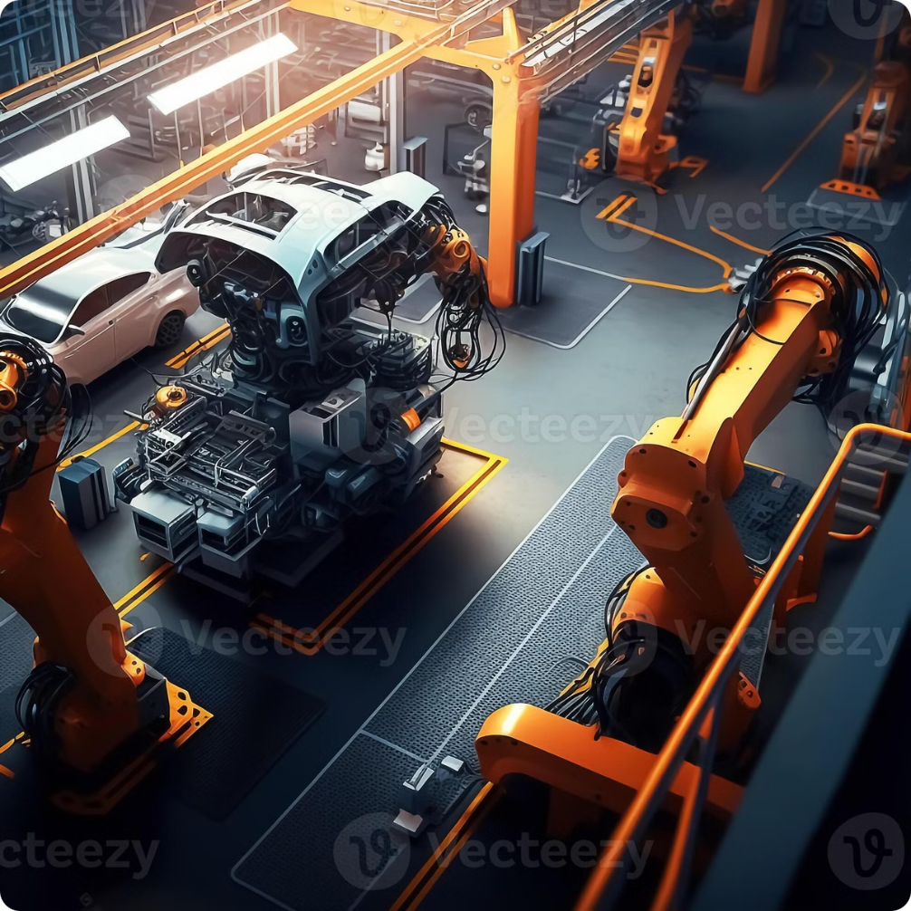
IIoT-Powered Smart Car Manufacturing and Digital Twin Integration for Cars
This presentation explores the exciting potential of IIoT ( Industrial Internet of Things ) and digital twins to revolutionize car manufacturing. Integrating these technologies enables enhanced production efficiency, real-time performance monitoring, and data-driven decision making. By leveraging connected devices and virtual representations of physical assets, we can optimize processes, improve quality, and drive innovation in the automotive industry.
Presented By : V D Panduranga Sai Guptha

Slide 2
Agenda
1
Introduction to IIoT in Manufacturing
2
Overview of Digital Twin Technology
Exploring the benefits and applications of Industrial Internet of Things in the manufacturing sector.
Understanding the concepts and potential of digital twin models in automotive production.
3
Project Objectives
4
System Architecture
Defining the goals and aims of this project, outlining key areas of focus.
Exploring the structure and components of the proposed IIoT system.
5
Role of OPC Server in Data Publishing
6
Cloud Integration and Data Analytics
Understanding the role of OPC server in data exchange and communication.
Examining how cloud platforms enable data storage, processing, and analysis.
7
Mobile and Actuator Control
8
Machine Learning and Predictive Modeling
Exploring mobile app integration and remote control of production processes.
Leveraging AI algorithms to optimize operations and predict future trends.

Slide 3

Introduction to IIoT in Manufacturing
Enhanced Efficiency
Real-Time Monitoring
IIoT optimizes production processes by automating tasks, reducing downtime, and improving resource allocation.
Sensors collect data in real-time, providing valuable insights into equipment performance and production status.
Data-Driven Decision Making
Improved Quality Control
IIoT enables data analytics, allowing manufacturers to identify trends, predict issues, and make informed decisions.
Real-time monitoring and feedback mechanisms ensure consistent product quality and minimize defects.

Slide 4
Overview of Digital Twin Technology
The Real World
The Digital World
A digital twin represents a physical asset, like a car, in the virtual world. This virtual representation mirrors the real-world asset's characteristics, including its design, components, and performance data.
Digital twins use real-time data from sensors and other sources to simulate the physical asset's behavior and predict its performance. This virtual model allows manufacturers to test different scenarios, optimize processes, and make data-driven decisions.

Slide 5
System Architecture for IIoT-Powered Smart Car Manufacturing
Sensors
1
Sensors on the shop floor collect real-time data on production processes, machine performance, and environmental conditions.
2
Data Acquisition
Data from sensors is collected and transmitted to the OPC server, acting as a central data hub.
OPC Server
3
The OPC server publishes and manages data from various sources, providing a standardized interface for communication.
4
Cloud Integration
Data is transferred to the cloud platform for storage, processing, and analysis, allowing for real-time monitoring and insights.
Decision Making
5
Analytical tools and AI algorithms process data, providing valuable insights for optimizing production and identifying potential issues.
6
Actuator Control
Based on analyzed data and user input, commands are sent back to the shop floor to control actuators and adjust production processes.
SCADA Tool
7
SCADA is a control system used for monitoring and managing industrial processes in real-time, enabling centralized data collection, visualization, and automation.

Slide 6
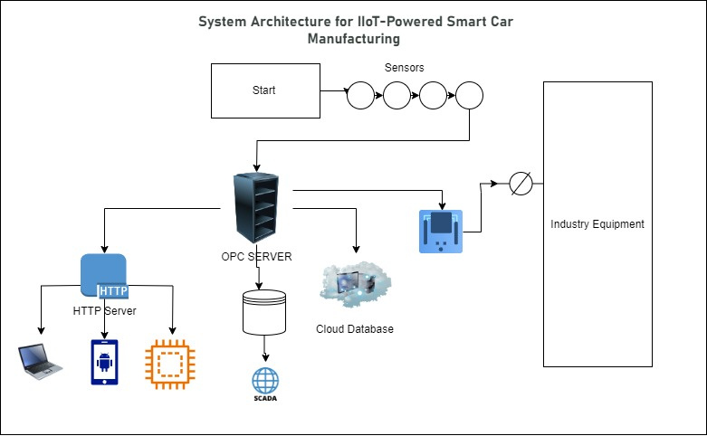

Slide 7
System Architecture for Digital Twin Integration for Cars
Sensor Installation
1
Sensors are installed in the vehicle to monitor various parameters such as engine performance, tire health, and environmental conditions. These sensors provide real-time data crucial for the digital twin model.
2
Data Collection
The sensors continuously collect data, ensuring comprehensive coverage of the vehicle's operational state. This real-time data forms the foundation for analysis and modeling in the digital twin..
OPC Server Configuration
3
An OPC (Open Platform Communications) server is set up to standardize communication between different sensor data sources. This server manages and publishes the collected data efficiently..
4
Data Transmission to Cloud
The collected data is transmitted to a cloud platform for secure storage and advanced processing. This enables powerful analytics and real-time insights into the vehicle’s performance.
Digital Twin Model Development
5
A digital twin of the car is created using the real-time sensor data, accurately reflecting its physical state. This model allows for simulation and analysis of the vehicle's behavior under various conditions.
6
User Interface Development
A user-friendly interface is developed for visualizing the digital twin and accessing insights. This interface enables users to monitor vehicle performance and receive alerts regarding potential issues.
Continuous Monitoring and Feedback
7
Continuous monitoring ensures the digital twin is updated with real-time data from the vehicle. A feedback loop allows adjustments based on insights derived from the digital twin, enhancing vehicle performance and maintenance.

Slide 8
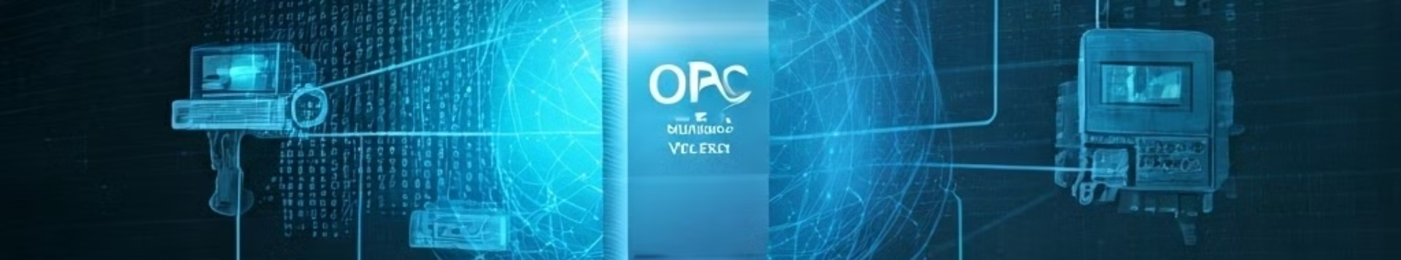




Role of OPC Server in Data Publishing
Data Aggregation
Standardized Communication
Data Security and Reliability
Real-Time Data Access
OPC Server gathers data from various sensors and devices on the shop floor, unifying it into a central repository.
Provides a universal interface for different devices and systems to exchange data seamlessly, ensuring interoperability.
Ensures data integrity and reliability, safeguarding against data loss and ensuring consistent information flow.
Enables real-time data access for monitoring, analysis, and control applications, enabling informed decision making.

Slide 9

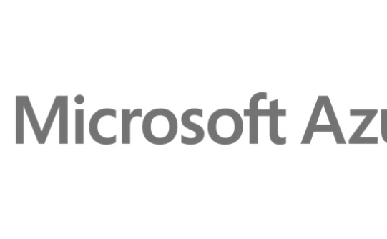

Cloud Integration and Data Analytics
AWS
Azure
Google Cloud Platform
Amazon Web Services offers a comprehensive suite of cloud computing services, including data storage, analytics, and machine learning, ideal for IIoT applications.
Microsoft Azure provides a robust cloud platform with extensive capabilities for data storage, analytics, and IoT solutions, supporting large-scale IIoT deployments.
Google Cloud Platform offers powerful data analytics tools and machine learning capabilities, enabling advanced insights and predictions in IIoT environments.

Slide 10
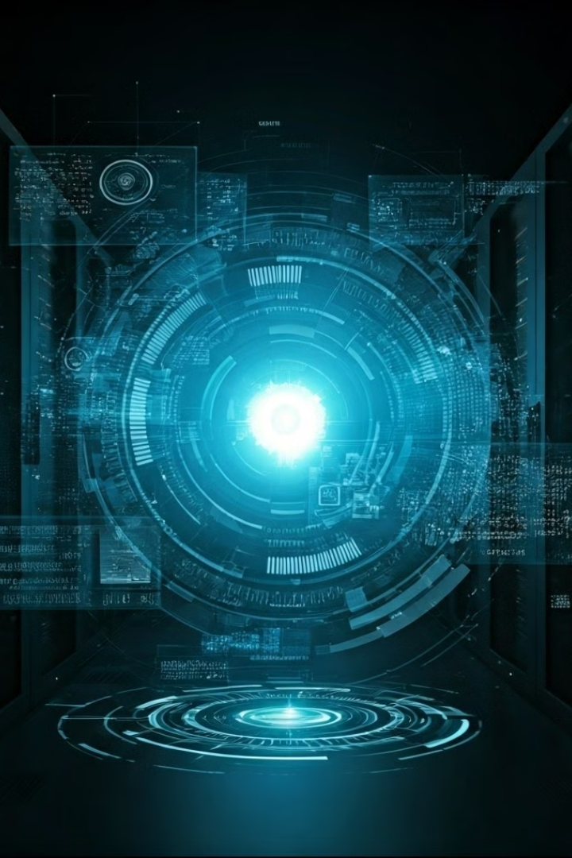




Machine Learning and Predictive Modeling Future Work
Data Collection and Preparation
Sensors gather real-time data from various sources, including machine performance, production line efficiency, and environmental conditions.
Model Training
Machine learning algorithms are trained on historical data to identify patterns and predict future behavior.
Predictive Analytics
Trained models analyze real-time data to predict potential issues, such as machine failure, production delays, or quality defects.
Actionable Insights
Predictions provide timely alerts, enabling proactive interventions and optimization of production processes.

Slide 11
Thanks
Contact Details:
V D Panduranga Sai Guptha
Final Year
SRM University AP
Saiguptha_v@srmap.edu.in
8688670712
https://www.linkedin.com/in/saiguptha2003/
https://github.com/saiguptha2003

